Slide 1
Find Path in A Maze: Algorithm

Slide 2
Why Are We here?

Slide 3
Why Are We here?
Curiosity of Creation

Slide 4

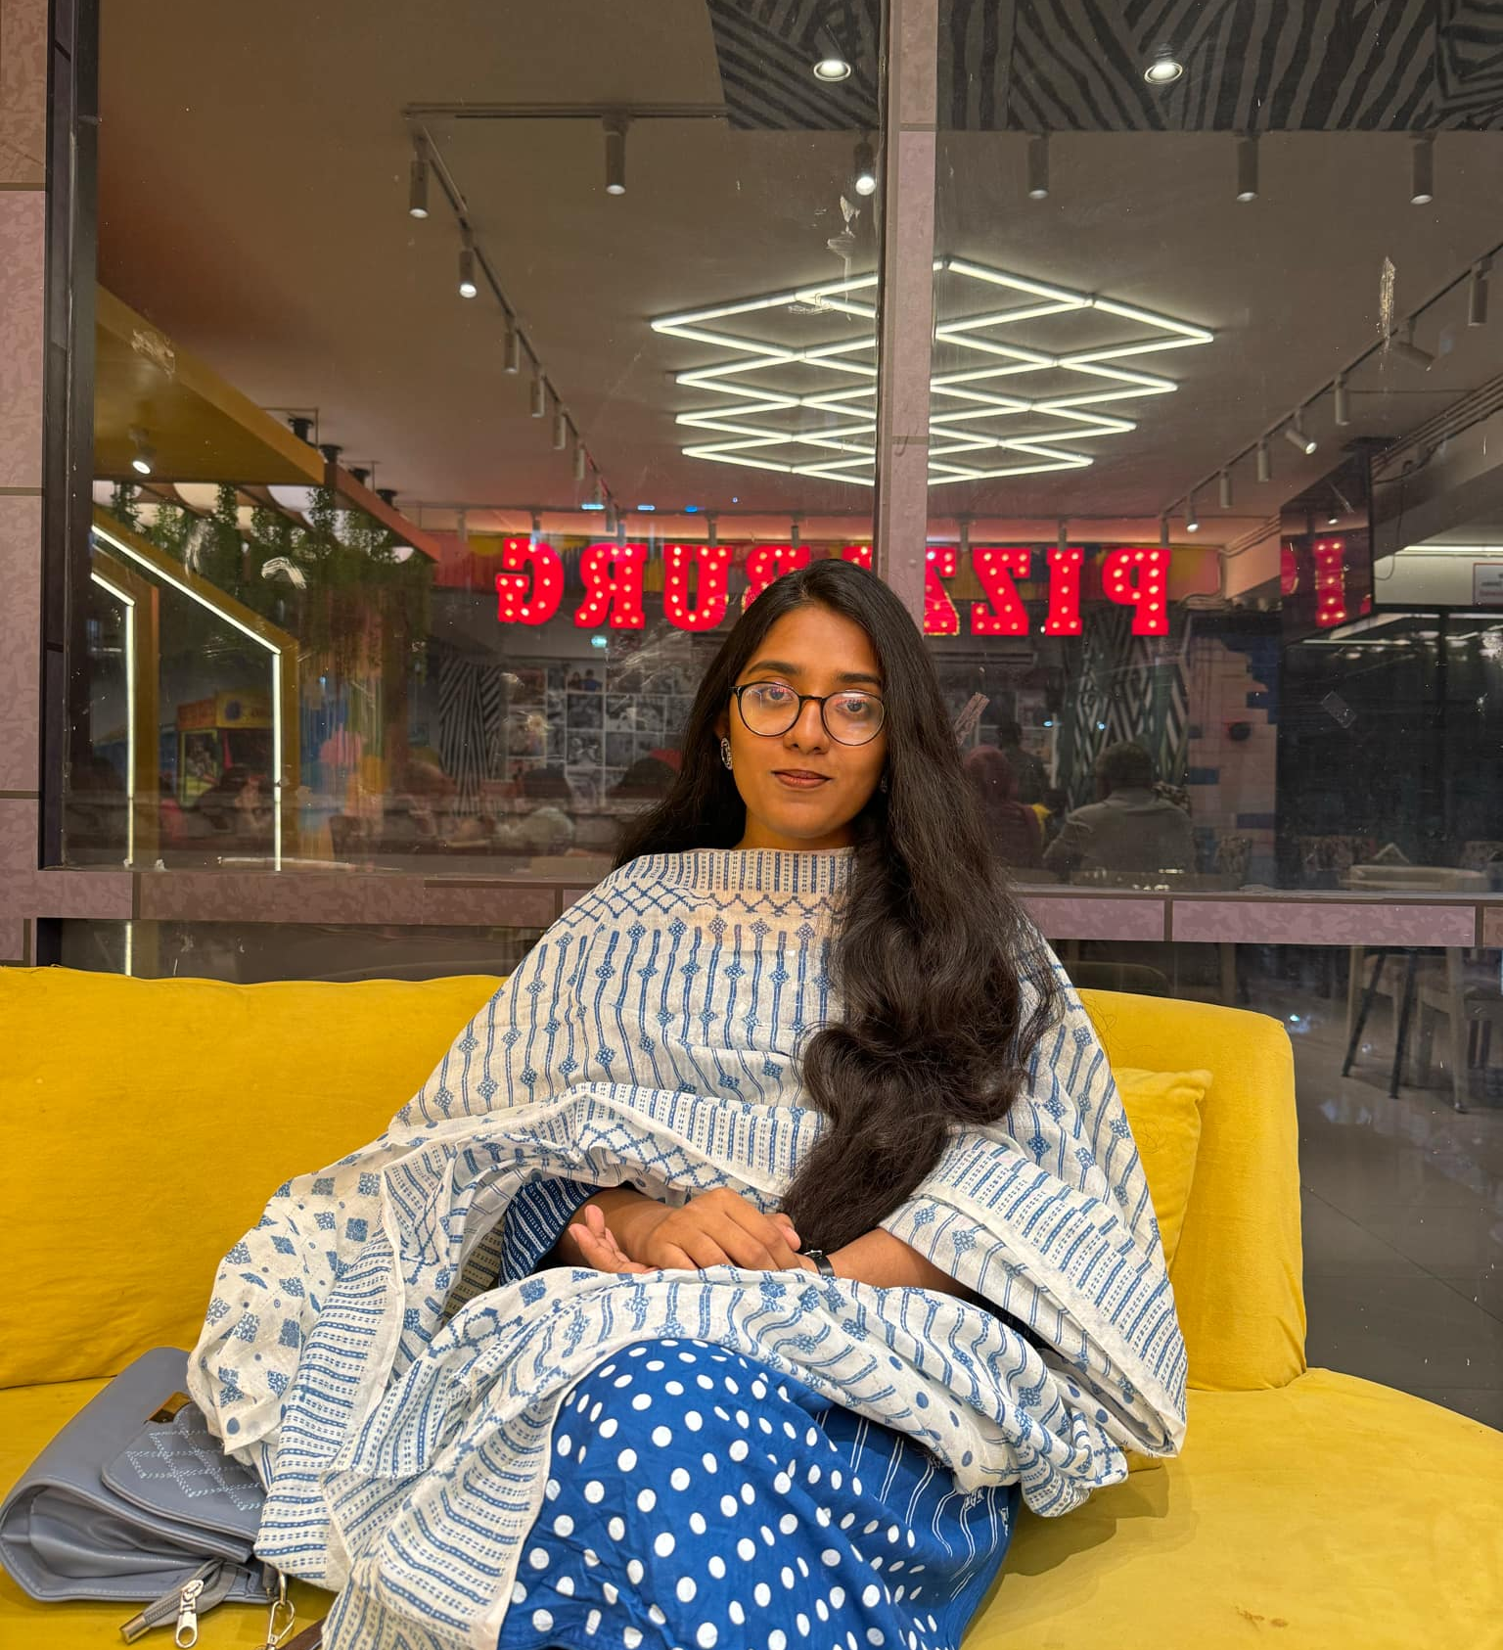
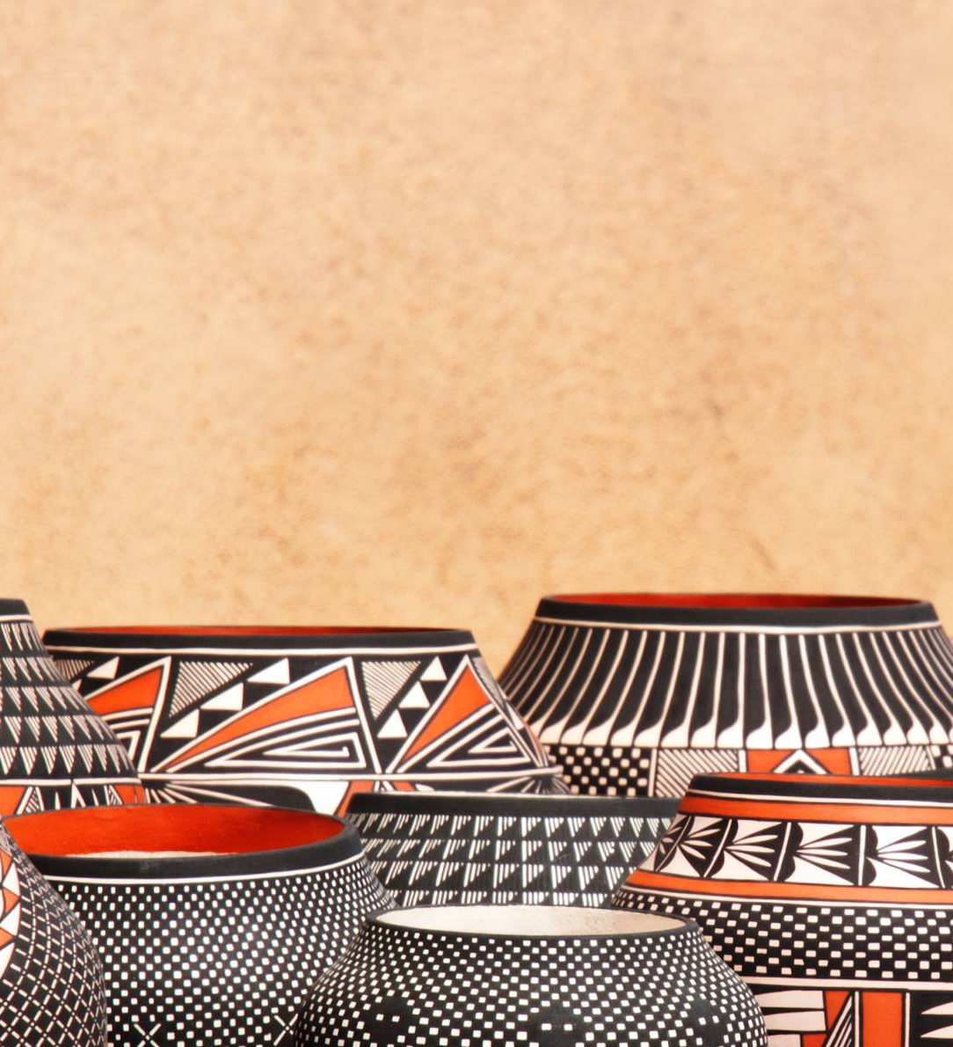
Meet THE Team:
Akhlak Hossain
2022-3-60-057
Saba Tasnim Khan
2022-3-60-049
MD. Muntasir Ahmed Rifat
2022-1-60-333

Slide 5
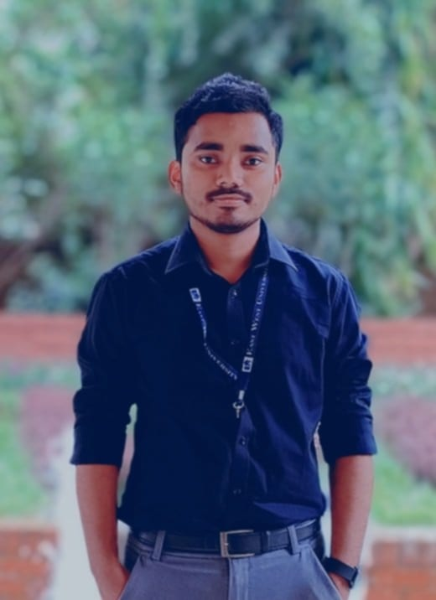
Meet THE Team:
Akhlak Hossain
2022-3-60-057
Saba Tasnim Khan
2022-3-60-049
MD. Muntasir Ahmed Rifat
2022-1-60-333

Slide 6
Meet THE Team:
Akhlak Hossain
2022-3-60-057
Saba Tasnim Khan
2022-3-60-049
MD. Muntasir Ahmed Rifat
2022-1-60-333

Slide 7
Meet THE Team:
Akhlak Hossain
2022-3-60-057
Saba Tasnim Khan
2022-3-60-049
MD. Muntasir Ahmed Rifat
2022-1-60-333

Slide 8
Introduction
ThePhoto by PhotoAuthor is licensed under CCYYSA.

Slide 9
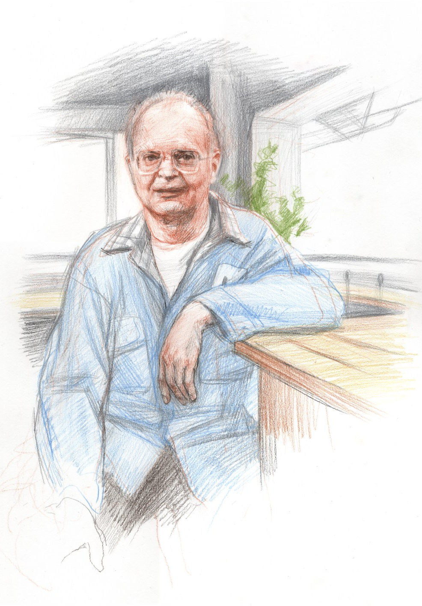
Introduction
backtracking
Algorithm
ThePhoto by PhotoAuthor is licensed under CCYYSA.

Slide 10
Introduction
backtracking
Algorithm
Donald Ervin Knuth
ThePhoto by PhotoAuthor is licensed under CCYYSA.

Slide 11
What were they trying to solve?

Slide 12

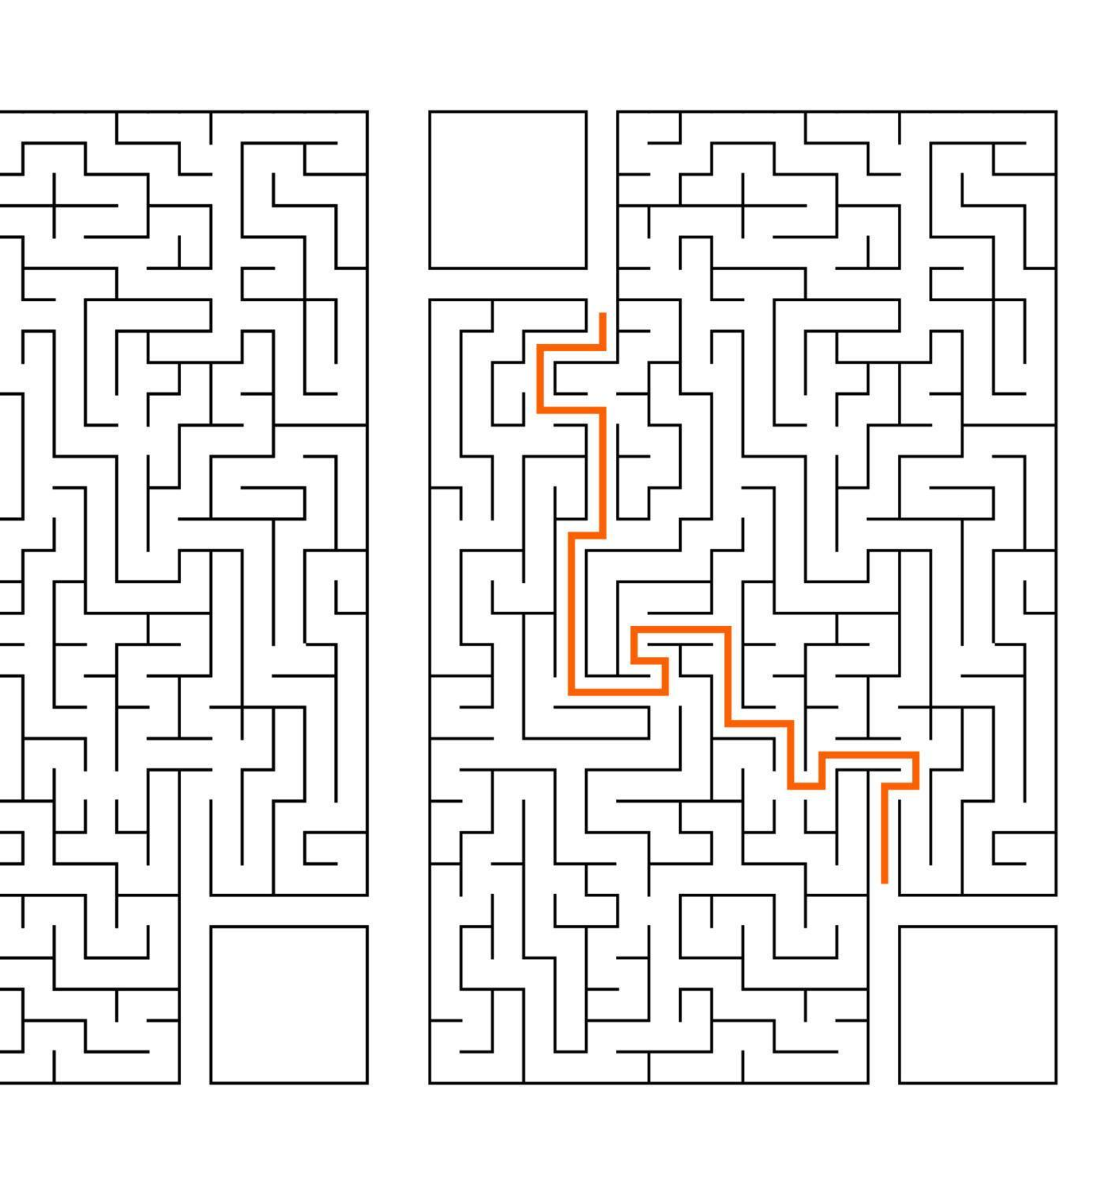
What were they trying to solve?
Efficiency
Pruning

Slide 13
Program Flow chart

Slide 14
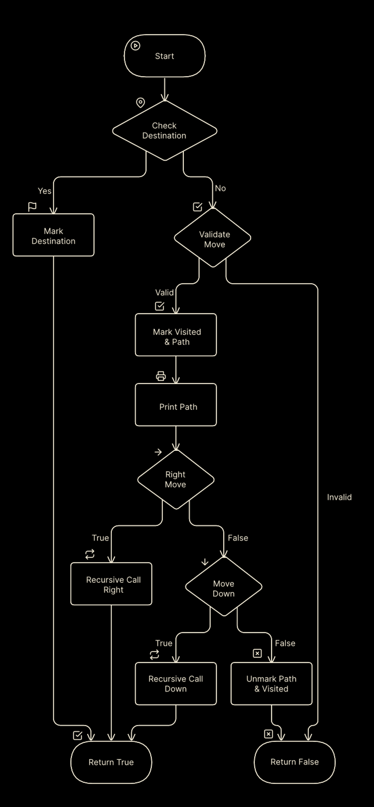
Program Flow chart

Slide 15
Program Flow chart

Slide 16
Program Flow chart

Slide 17

The Maze The Input

Slide 18
The Maze The Input
12 1 0 0 0 0 0 0 0 0 0 0 0 1 1 1 0 1 1 0 0 0 0 0 0 0 0 1 0 0 1 0 0 0 0 0 0 0 0 1 1 0 1 1 1 1 1 1 0 0 0 0 1 0 0 0 0 0 0 1 0 0 0 0 1 1 1 0 0 0 0 1 0 0 0 0 0 0 1 0 0 0 0 1 0 0 0 0 0 0 1 1 1 1 0 1 0 0 0 0 0 0 0 0 0 1 0 1 0 1 1 1 1 1 1 1 0 1 1 1 0 0 0 0 0 0 0 0 0 0 0 1 0 0 0 0 0 0 0 0 0 0 0 1 1

Slide 19
The Magic
1 0 0 0 0 0 0 0 0 0 0 0
0 0 0 0 0 0 0 0 0 0 0 0
0 0 0 0 0 0 0 0 0 0 0 0
0 0 0 0 0 0 0 0 0 0 0 0
0 0 0 0 0 0 0 0 0 0 0 0
0 0 0 0 0 0 0 0 0 0 0 0
0 0 0 0 0 0 0 0 0 0 0 0
0 0 0 0 0 0 0 0 0 0 0 0
0 0 0 0 0 0 0 0 0 0 0 0
0 0 0 0 0 0 0 0 0 0 0 0
0 0 0 0 0 0 0 0 0 0 0 0
0 0 0 0 0 0 0 0 0 0 0 0
Backtracking

Slide 20
The Magic
1 0 0 0 0 0 0 0 0 0 0 0
0 0 0 0 0 0 0 0 0 0 0 0
0 0 0 0 0 0 0 0 0 0 0 0
0 0 0 0 0 0 0 0 0 0 0 0
0 0 0 0 0 0 0 0 0 0 0 0
0 0 0 0 0 0 0 0 0 0 0 0
0 0 0 0 0 0 0 0 0 0 0 0
0 0 0 0 0 0 0 0 0 0 0 0
0 0 0 0 0 0 0 0 0 0 0 0
0 0 0 0 0 0 0 0 0 0 0 0
0 0 0 0 0 0 0 0 0 0 0 0
0 0 0 0 0 0 0 0 0 0 0 0
1 0 0 0 0 0 0 0 0 0 0 0
1 1 1 0 1 1 0 0 0 0 0 0
0 0 1 0 0 1 0 0 0 0 0 0
0 0 1 1 0 1 1 1 1 1 1 0
0 0 0 1 0 0 0 0 0 0 1 0
0 0 0 1 1 1 0 0 0 0 1 0
0 0 0 0 0 1 0 0 0 0 1 0
0 0 0 0 0 1 1 1 1 0 1 0
0 0 0 0 0 0 0 0 1 0 1 0
1 1 1 1 1 1 1 0 1 1 1 0
0 0 0 0 0 0 0 0 0 0 1 0
0 0 0 0 0 0 0 0 0 0 1 1
Backtracking

Slide 21
The Magic
1 0 0 0 0 0 0 0 0 0 0 0
1 0 0 0 0 0 0 0 0 0 0 0
0 0 0 0 0 0 0 0 0 0 0 0
0 0 0 0 0 0 0 0 0 0 0 0
0 0 0 0 0 0 0 0 0 0 0 0
0 0 0 0 0 0 0 0 0 0 0 0
0 0 0 0 0 0 0 0 0 0 0 0
0 0 0 0 0 0 0 0 0 0 0 0
0 0 0 0 0 0 0 0 0 0 0 0
0 0 0 0 0 0 0 0 0 0 0 0
0 0 0 0 0 0 0 0 0 0 0 0
0 0 0 0 0 0 0 0 0 0 0 0
1 0 0 0 0 0 0 0 0 0 0 0
1 1 1 0 1 1 0 0 0 0 0 0
0 0 1 0 0 1 0 0 0 0 0 0
0 0 1 1 0 1 1 1 1 1 1 0
0 0 0 1 0 0 0 0 0 0 1 0
0 0 0 1 1 1 0 0 0 0 1 0
0 0 0 0 0 1 0 0 0 0 1 0
0 0 0 0 0 1 1 1 1 0 1 0
0 0 0 0 0 0 0 0 1 0 1 0
1 1 1 1 1 1 1 0 1 1 1 0
0 0 0 0 0 0 0 0 0 0 1 0
0 0 0 0 0 0 0 0 0 0 1 1`
Backtracking

Slide 22
The Magic
1 0 0 0 0 0 0 0 0 0 0 0
1 1 0 0 0 0 0 0 0 0 0 0
0 0 0 0 0 0 0 0 0 0 0 0
0 0 0 0 0 0 0 0 0 0 0 0
0 0 0 0 0 0 0 0 0 0 0 0
0 0 0 0 0 0 0 0 0 0 0 0
0 0 0 0 0 0 0 0 0 0 0 0
0 0 0 0 0 0 0 0 0 0 0 0
0 0 0 0 0 0 0 0 0 0 0 0
0 0 0 0 0 0 0 0 0 0 0 0
0 0 0 0 0 0 0 0 0 0 0 0
0 0 0 0 0 0 0 0 0 0 0 0
1 0 0 0 0 0 0 0 0 0 0 0
1 1 1 0 1 1 0 0 0 0 0 0
0 0 1 0 0 1 0 0 0 0 0 0
0 0 1 1 0 1 1 1 1 1 1 0
0 0 0 1 0 0 0 0 0 0 1 0
0 0 0 1 1 1 0 0 0 0 1 0
0 0 0 0 0 1 0 0 0 0 1 0
0 0 0 0 0 1 1 1 1 0 1 0
0 0 0 0 0 0 0 0 1 0 1 0
1 1 1 1 1 1 1 0 1 1 1 0
0 0 0 0 0 0 0 0 0 0 1 0
0 0 0 0 0 0 0 0 0 0 1 1
Backtracking

Slide 23
The Magic
1 0 0 0 0 0 0 0 0 0 0 0
1 1 1 0 0 0 0 0 0 0 0 0
0 0 0 0 0 0 0 0 0 0 0 0
0 0 0 0 0 0 0 0 0 0 0 0
0 0 0 0 0 0 0 0 0 0 0 0
0 0 0 0 0 0 0 0 0 0 0 0
0 0 0 0 0 0 0 0 0 0 0 0
0 0 0 0 0 0 0 0 0 0 0 0
0 0 0 0 0 0 0 0 0 0 0 0
0 0 0 0 0 0 0 0 0 0 0 0
0 0 0 0 0 0 0 0 0 0 0 0
0 0 0 0 0 0 0 0 0 0 0 0
1 0 0 0 0 0 0 0 0 0 0 0
1 1 1 0 1 1 0 0 0 0 0 0
0 0 1 0 0 1 0 0 0 0 0 0
0 0 1 1 0 1 1 1 1 1 1 0
0 0 0 1 0 0 0 0 0 0 1 0
0 0 0 1 1 1 0 0 0 0 1 0
0 0 0 0 0 1 0 0 0 0 1 0
0 0 0 0 0 1 1 1 1 0 1 0
0 0 0 0 0 0 0 0 1 0 1 0
1 1 1 1 1 1 1 0 1 1 1 0
0 0 0 0 0 0 0 0 0 0 1 0
0 0 0 0 0 0 0 0 0 0 1 1
Backtracking

Slide 24
The Magic
1 0 0 0 0 0 0 0 0 0 0 0
1 1 1 0 0 0 0 0 0 0 0 0
0 0 1 0 0 0 0 0 0 0 0 0
0 0 0 0 0 0 0 0 0 0 0 0
0 0 0 0 0 0 0 0 0 0 0 0
0 0 0 0 0 0 0 0 0 0 0 0
0 0 0 0 0 0 0 0 0 0 0 0
0 0 0 0 0 0 0 0 0 0 0 0
0 0 0 0 0 0 0 0 0 0 0 0
0 0 0 0 0 0 0 0 0 0 0 0
0 0 0 0 0 0 0 0 0 0 0 0
0 0 0 0 0 0 0 0 0 0 0 0
1 0 0 0 0 0 0 0 0 0 0 0
1 1 1 0 1 1 0 0 0 0 0 0
0 0 1 0 0 1 0 0 0 0 0 0
0 0 1 1 0 1 1 1 1 1 1 0
0 0 0 1 0 0 0 0 0 0 1 0
0 0 0 1 1 1 0 0 0 0 1 0
0 0 0 0 0 1 0 0 0 0 1 0
0 0 0 0 0 1 1 1 1 0 1 0
0 0 0 0 0 0 0 0 1 0 1 0
1 1 1 1 1 1 1 0 1 1 1 0
0 0 0 0 0 0 0 0 0 0 1 0
0 0 0 0 0 0 0 0 0 0 1 1
Backtracking

Slide 25
The Magic
1 0 0 0 0 0 0 0 0 0 0 0
1 1 1 0 0 0 0 0 0 0 0 0
0 0 1 0 0 0 0 0 0 0 0 0
0 0 1 0 0 0 0 0 0 0 0 0
0 0 0 0 0 0 0 0 0 0 0 0
0 0 0 0 0 0 0 0 0 0 0 0
0 0 0 0 0 0 0 0 0 0 0 0
0 0 0 0 0 0 0 0 0 0 0 0
0 0 0 0 0 0 0 0 0 0 0 0
0 0 0 0 0 0 0 0 0 0 0 0
0 0 0 0 0 0 0 0 0 0 0 0
0 0 0 0 0 0 0 0 0 0 0 0
1 0 0 0 0 0 0 0 0 0 0 0
1 1 1 0 1 1 0 0 0 0 0 0
0 0 1 0 0 1 0 0 0 0 0 0
0 0 1 1 0 1 1 1 1 1 1 0
0 0 0 1 0 0 0 0 0 0 1 0
0 0 0 1 1 1 0 0 0 0 1 0
0 0 0 0 0 1 0 0 0 0 1 0
0 0 0 0 0 1 1 1 1 0 1 0
0 0 0 0 0 0 0 0 1 0 1 0
1 1 1 1 1 1 1 0 1 1 1 0
0 0 0 0 0 0 0 0 0 0 1 0
0 0 0 0 0 0 0 0 0 0 1 1
Backtracking

Slide 26
The Magic
1 0 0 0 0 0 0 0 0 0 0 0
1 1 1 0 0 0 0 0 0 0 0 0
0 0 1 0 0 0 0 0 0 0 0 0
0 0 1 1 0 0 0 0 0 0 0 0
0 0 0 0 0 0 0 0 0 0 0 0
0 0 0 0 0 0 0 0 0 0 0 0
0 0 0 0 0 0 0 0 0 0 0 0
0 0 0 0 0 0 0 0 0 0 0 0
0 0 0 0 0 0 0 0 0 0 0 0
0 0 0 0 0 0 0 0 0 0 0 0
0 0 0 0 0 0 0 0 0 0 0 0
0 0 0 0 0 0 0 0 0 0 0 0
1 0 0 0 0 0 0 0 0 0 0 0
1 1 1 0 1 1 0 0 0 0 0 0
0 0 1 0 0 1 0 0 0 0 0 0
0 0 1 1 0 1 1 1 1 1 1 0
0 0 0 1 0 0 0 0 0 0 1 0
0 0 0 1 1 1 0 0 0 0 1 0
0 0 0 0 0 1 0 0 0 0 1 0
0 0 0 0 0 1 1 1 1 0 1 0
0 0 0 0 0 0 0 0 1 0 1 0
1 1 1 1 1 1 1 0 1 1 1 0
0 0 0 0 0 0 0 0 0 0 1 0
0 0 0 0 0 0 0 0 0 0 1 1
Backtracking

Slide 27
The Magic
1 0 0 0 0 0 0 0 0 0 0 0
1 1 1 0 0 0 0 0 0 0 0 0
0 0 1 0 0 0 0 0 0 0 0 0
0 0 1 1 0 0 0 0 0 0 0 0
0 0 0 1 0 0 0 0 0 0 0 0
0 0 0 0 0 0 0 0 0 0 0 0
0 0 0 0 0 0 0 0 0 0 0 0
0 0 0 0 0 0 0 0 0 0 0 0
0 0 0 0 0 0 0 0 0 0 0 0
0 0 0 0 0 0 0 0 0 0 0 0
0 0 0 0 0 0 0 0 0 0 0 0
0 0 0 0 0 0 0 0 0 0 0 0
1 0 0 0 0 0 0 0 0 0 0 0
1 1 1 0 1 1 0 0 0 0 0 0
0 0 1 0 0 1 0 0 0 0 0 0
0 0 1 1 0 1 1 1 1 1 1 0
0 0 0 1 0 0 0 0 0 0 1 0
0 0 0 1 1 1 0 0 0 0 1 0
0 0 0 0 0 1 0 0 0 0 1 0
0 0 0 0 0 1 1 1 1 0 1 0
0 0 0 0 0 0 0 0 1 0 1 0
1 1 1 1 1 1 1 0 1 1 1 0
0 0 0 0 0 0 0 0 0 0 1 0
0 0 0 0 0 0 0 0 0 0 1 1
Backtracking

Slide 28
The Magic
1 0 0 0 0 0 0 0 0 0 0 0
1 1 1 0 0 0 0 0 0 0 0 0
0 0 1 0 0 0 0 0 0 0 0 0
0 0 1 1 0 0 0 0 0 0 0 0
0 0 0 1 0 0 0 0 0 0 0 0
0 0 0 1 0 0 0 0 0 0 0 0
0 0 0 0 0 0 0 0 0 0 0 0
0 0 0 0 0 0 0 0 0 0 0 0
0 0 0 0 0 0 0 0 0 0 0 0
0 0 0 0 0 0 0 0 0 0 0 0
0 0 0 0 0 0 0 0 0 0 0 0
0 0 0 0 0 0 0 0 0 0 0 0
1 0 0 0 0 0 0 0 0 0 0 0
1 1 1 0 1 1 0 0 0 0 0 0
0 0 1 0 0 1 0 0 0 0 0 0
0 0 1 1 0 1 1 1 1 1 1 0
0 0 0 1 0 0 0 0 0 0 1 0
0 0 0 1 1 1 0 0 0 0 1 0
0 0 0 0 0 1 0 0 0 0 1 0
0 0 0 0 0 1 1 1 1 0 1 0
0 0 0 0 0 0 0 0 1 0 1 0
1 1 1 1 1 1 1 0 1 1 1 0
0 0 0 0 0 0 0 0 0 0 1 0
0 0 0 0 0 0 0 0 0 0 1 1
Backtracking

Slide 29
The Magic
1 0 0 0 0 0 0 0 0 0 0 0
1 1 1 0 0 0 0 0 0 0 0 0
0 0 1 0 0 0 0 0 0 0 0 0
0 0 1 1 0 0 0 0 0 0 0 0
0 0 0 1 0 0 0 0 0 0 0 0
0 0 0 1 1 0 0 0 0 0 0 0
0 0 0 0 0 0 0 0 0 0 0 0
0 0 0 0 0 0 0 0 0 0 0 0
0 0 0 0 0 0 0 0 0 0 0 0
0 0 0 0 0 0 0 0 0 0 0 0
0 0 0 0 0 0 0 0 0 0 0 0
0 0 0 0 0 0 0 0 0 0 0 0
1 0 0 0 0 0 0 0 0 0 0 0
1 1 1 0 1 1 0 0 0 0 0 0
0 0 1 0 0 1 0 0 0 0 0 0
0 0 1 1 0 1 1 1 1 1 1 0
0 0 0 1 0 0 0 0 0 0 1 0
0 0 0 1 1 1 0 0 0 0 1 0
0 0 0 0 0 1 0 0 0 0 1 0
0 0 0 0 0 1 1 1 1 0 1 0
0 0 0 0 0 0 0 0 1 0 1 0
1 1 1 1 1 1 1 0 1 1 1 0
0 0 0 0 0 0 0 0 0 0 1 0
0 0 0 0 0 0 0 0 0 0 1 1
Backtracking

Slide 30
The Magic
1 0 0 0 0 0 0 0 0 0 0 0
1 1 1 0 0 0 0 0 0 0 0 0
0 0 1 0 0 0 0 0 0 0 0 0
0 0 1 1 0 0 0 0 0 0 0 0
0 0 0 1 0 0 0 0 0 0 0 0
0 0 0 1 1 1 0 0 0 0 0 0
0 0 0 0 0 0 0 0 0 0 0 0
0 0 0 0 0 0 0 0 0 0 0 0
0 0 0 0 0 0 0 0 0 0 0 0
0 0 0 0 0 0 0 0 0 0 0 0
0 0 0 0 0 0 0 0 0 0 0 0
0 0 0 0 0 0 0 0 0 0 0 0
1 0 0 0 0 0 0 0 0 0 0 0
1 1 1 0 1 1 0 0 0 0 0 0
0 0 1 0 0 1 0 0 0 0 0 0
0 0 1 1 0 1 1 1 1 1 1 0
0 0 0 1 0 0 0 0 0 0 1 0
0 0 0 1 1 1 0 0 0 0 1 0
0 0 0 0 0 1 0 0 0 0 1 0
0 0 0 0 0 1 1 1 1 0 1 0
0 0 0 0 0 0 0 0 1 0 1 0
1 1 1 1 1 1 1 0 1 1 1 0
0 0 0 0 0 0 0 0 0 0 1 0
0 0 0 0 0 0 0 0 0 0 1 1
Backtracking

Slide 31
The Magic
1 0 0 0 0 0 0 0 0 0 0 0
1 1 1 0 0 0 0 0 0 0 0 0
0 0 1 0 0 0 0 0 0 0 0 0
0 0 1 1 0 0 0 0 0 0 0 0
0 0 0 1 0 0 0 0 0 0 0 0
0 0 0 1 1 1 0 0 0 0 0 0
0 0 0 0 0 1 0 0 0 0 0 0
0 0 0 0 0 0 0 0 0 0 0 0
0 0 0 0 0 0 0 0 0 0 0 0
0 0 0 0 0 0 0 0 0 0 0 0
0 0 0 0 0 0 0 0 0 0 0 0
0 0 0 0 0 0 0 0 0 0 0 0
1 0 0 0 0 0 0 0 0 0 0 0
1 1 1 0 1 1 0 0 0 0 0 0
0 0 1 0 0 1 0 0 0 0 0 0
0 0 1 1 0 1 1 1 1 1 1 0
0 0 0 1 0 0 0 0 0 0 1 0
0 0 0 1 1 1 0 0 0 0 1 0
0 0 0 0 0 1 0 0 0 0 1 0
0 0 0 0 0 1 1 1 1 0 1 0
0 0 0 0 0 0 0 0 1 0 1 0
1 1 1 1 1 1 1 0 1 1 1 0
0 0 0 0 0 0 0 0 0 0 1 0
0 0 0 0 0 0 0 0 0 0 1 1
Backtracking

Slide 32
The Magic
1 0 0 0 0 0 0 0 0 0 0 0
1 1 1 0 0 0 0 0 0 0 0 0
0 0 1 0 0 0 0 0 0 0 0 0
0 0 1 1 0 0 0 0 0 0 0 0
0 0 0 1 0 0 0 0 0 0 0 0
0 0 0 1 1 1 0 0 0 0 0 0
0 0 0 0 0 1 0 0 0 0 0 0
0 0 0 0 0 1 0 0 0 0 0 0
0 0 0 0 0 0 0 0 0 0 0 0
0 0 0 0 0 0 0 0 0 0 0 0
0 0 0 0 0 0 0 0 0 0 0 0
0 0 0 0 0 0 0 0 0 0 0 0
1 0 0 0 0 0 0 0 0 0 0 0
1 1 1 0 1 1 0 0 0 0 0 0
0 0 1 0 0 1 0 0 0 0 0 0
0 0 1 1 0 1 1 1 1 1 1 0
0 0 0 1 0 0 0 0 0 0 1 0
0 0 0 1 1 1 0 0 0 0 1 0
0 0 0 0 0 1 0 0 0 0 1 0
0 0 0 0 0 1 1 1 1 0 1 0
0 0 0 0 0 0 0 0 1 0 1 0
1 1 1 1 1 1 1 0 1 1 1 0
0 0 0 0 0 0 0 0 0 0 1 0
0 0 0 0 0 0 0 0 0 0 1 1
Backtracking

Slide 33
The Magic
1 0 0 0 0 0 0 0 0 0 0 0
1 1 1 0 0 0 0 0 0 0 0 0
0 0 1 0 0 0 0 0 0 0 0 0
0 0 1 1 0 0 0 0 0 0 0 0
0 0 0 1 0 0 0 0 0 0 0 0
0 0 0 1 1 1 0 0 0 0 0 0
0 0 0 0 0 1 0 0 0 0 0 0
0 0 0 0 0 1 1 0 0 0 0 0
0 0 0 0 0 0 0 0 0 0 0 0
0 0 0 0 0 0 0 0 0 0 0 0
0 0 0 0 0 0 0 0 0 0 0 0
0 0 0 0 0 0 0 0 0 0 0 0
1 0 0 0 0 0 0 0 0 0 0 0
1 1 1 0 1 1 0 0 0 0 0 0
0 0 1 0 0 1 0 0 0 0 0 0
0 0 1 1 0 1 1 1 1 1 1 0
0 0 0 1 0 0 0 0 0 0 1 0
0 0 0 1 1 1 0 0 0 0 1 0
0 0 0 0 0 1 0 0 0 0 1 0
0 0 0 0 0 1 1 1 1 0 1 0
0 0 0 0 0 0 0 0 1 0 1 0
1 1 1 1 1 1 1 0 1 1 1 0
0 0 0 0 0 0 0 0 0 0 1 0
0 0 0 0 0 0 0 0 0 0 1 1
Backtracking

Slide 34
The Magic
1 0 0 0 0 0 0 0 0 0 0 0
1 1 1 0 0 0 0 0 0 0 0 0
0 0 1 0 0 0 0 0 0 0 0 0
0 0 1 1 0 0 0 0 0 0 0 0
0 0 0 1 0 0 0 0 0 0 0 0
0 0 0 1 1 1 0 0 0 0 0 0
0 0 0 0 0 1 0 0 0 0 0 0
0 0 0 0 0 1 1 1 0 0 0 0
0 0 0 0 0 0 0 0 0 0 0 0
0 0 0 0 0 0 0 0 0 0 0 0
0 0 0 0 0 0 0 0 0 0 0 0
0 0 0 0 0 0 0 0 0 0 0 0
1 0 0 0 0 0 0 0 0 0 0 0
1 1 1 0 1 1 0 0 0 0 0 0
0 0 1 0 0 1 0 0 0 0 0 0
0 0 1 1 0 1 1 1 1 1 1 0
0 0 0 1 0 0 0 0 0 0 1 0
0 0 0 1 1 1 0 0 0 0 1 0
0 0 0 0 0 1 0 0 0 0 1 0
0 0 0 0 0 1 1 1 1 0 1 0
0 0 0 0 0 0 0 0 1 0 1 0
1 1 1 1 1 1 1 0 1 1 1 0
0 0 0 0 0 0 0 0 0 0 1 0
0 0 0 0 0 0 0 0 0 0 1 1
Backtracking

Slide 35
The Magic
1 0 0 0 0 0 0 0 0 0 0 0
1 1 1 0 0 0 0 0 0 0 0 0
0 0 1 0 0 0 0 0 0 0 0 0
0 0 1 1 0 0 0 0 0 0 0 0
0 0 0 1 0 0 0 0 0 0 0 0
0 0 0 1 1 1 0 0 0 0 0 0
0 0 0 0 0 1 0 0 0 0 0 0
0 0 0 0 0 1 1 1 1 0 0 0
0 0 0 0 0 0 0 0 0 0 0 0
0 0 0 0 0 0 0 0 0 0 0 0
0 0 0 0 0 0 0 0 0 0 0 0
0 0 0 0 0 0 0 0 0 0 0 0
1 0 0 0 0 0 0 0 0 0 0 0
1 1 1 0 1 1 0 0 0 0 0 0
0 0 1 0 0 1 0 0 0 0 0 0
0 0 1 1 0 1 1 1 1 1 1 0
0 0 0 1 0 0 0 0 0 0 1 0
0 0 0 1 1 1 0 0 0 0 1 0
0 0 0 0 0 1 0 0 0 0 1 0
0 0 0 0 0 1 1 1 1 0 1 0
0 0 0 0 0 0 0 0 1 0 1 0
1 1 1 1 1 1 1 0 1 1 1 0
0 0 0 0 0 0 0 0 0 0 1 0
0 0 0 0 0 0 0 0 0 0 1 1
Backtracking

Slide 36
The Magic
1 0 0 0 0 0 0 0 0 0 0 0
1 1 1 0 0 0 0 0 0 0 0 0
0 0 1 0 0 0 0 0 0 0 0 0
0 0 1 1 0 0 0 0 0 0 0 0
0 0 0 1 0 0 0 0 0 0 0 0
0 0 0 1 1 1 0 0 0 0 0 0
0 0 0 0 0 1 0 0 0 0 0 0
0 0 0 0 0 1 1 1 1 0 0 0
0 0 0 0 0 0 0 0 1 0 0 0
0 0 0 0 0 0 0 0 0 0 0 0
0 0 0 0 0 0 0 0 0 0 0 0
0 0 0 0 0 0 0 0 0 0 0 0
1 0 0 0 0 0 0 0 0 0 0 0
1 1 1 0 1 1 0 0 0 0 0 0
0 0 1 0 0 1 0 0 0 0 0 0
0 0 1 1 0 1 1 1 1 1 1 0
0 0 0 1 0 0 0 0 0 0 1 0
0 0 0 1 1 1 0 0 0 0 1 0
0 0 0 0 0 1 0 0 0 0 1 0
0 0 0 0 0 1 1 1 1 0 1 0
0 0 0 0 0 0 0 0 1 0 1 0
1 1 1 1 1 1 1 0 1 1 1 0
0 0 0 0 0 0 0 0 0 0 1 0
0 0 0 0 0 0 0 0 0 0 1 1
Backtracking

Slide 37
The Magic
1 0 0 0 0 0 0 0 0 0 0 0
1 1 1 0 0 0 0 0 0 0 0 0
0 0 1 0 0 0 0 0 0 0 0 0
0 0 1 1 0 0 0 0 0 0 0 0
0 0 0 1 0 0 0 0 0 0 0 0
0 0 0 1 1 1 0 0 0 0 0 0
0 0 0 0 0 1 0 0 0 0 0 0
0 0 0 0 0 1 1 1 1 0 0 0
0 0 0 0 0 0 0 0 1 0 0 0
0 0 0 0 0 0 0 0 1 0 0 0
0 0 0 0 0 0 0 0 0 0 0 0
0 0 0 0 0 0 0 0 0 0 0 0
1 0 0 0 0 0 0 0 0 0 0 0
1 1 1 0 1 1 0 0 0 0 0 0
0 0 1 0 0 1 0 0 0 0 0 0
0 0 1 1 0 1 1 1 1 1 1 0
0 0 0 1 0 0 0 0 0 0 1 0
0 0 0 1 1 1 0 0 0 0 1 0
0 0 0 0 0 1 0 0 0 0 1 0
0 0 0 0 0 1 1 1 1 0 1 0
0 0 0 0 0 0 0 0 1 0 1 0
1 1 1 1 1 1 1 0 1 1 1 0
0 0 0 0 0 0 0 0 0 0 1 0
0 0 0 0 0 0 0 0 0 0 1 1
Backtracking

Slide 38
The Magic
1 0 0 0 0 0 0 0 0 0 0 0
1 1 1 0 0 0 0 0 0 0 0 0
0 0 1 0 0 0 0 0 0 0 0 0
0 0 1 1 0 0 0 0 0 0 0 0
0 0 0 1 0 0 0 0 0 0 0 0
0 0 0 1 1 1 0 0 0 0 0 0
0 0 0 0 0 1 0 0 0 0 0 0
0 0 0 0 0 1 1 1 1 0 0 0
0 0 0 0 0 0 0 0 1 0 0 0
0 0 0 0 0 0 0 0 1 1 0 0
0 0 0 0 0 0 0 0 0 0 0 0
0 0 0 0 0 0 0 0 0 0 0 0
1 0 0 0 0 0 0 0 0 0 0 0
1 1 1 0 1 1 0 0 0 0 0 0
0 0 1 0 0 1 0 0 0 0 0 0
0 0 1 1 0 1 1 1 1 1 1 0
0 0 0 1 0 0 0 0 0 0 1 0
0 0 0 1 1 1 0 0 0 0 1 0
0 0 0 0 0 1 0 0 0 0 1 0
0 0 0 0 0 1 1 1 1 0 1 0
0 0 0 0 0 0 0 0 1 0 1 0
1 1 1 1 1 1 1 0 1 1 1 0
0 0 0 0 0 0 0 0 0 0 1 0
0 0 0 0 0 0 0 0 0 0 1 1
Backtracking

Slide 39
The Magic
1 0 0 0 0 0 0 0 0 0 0 0
1 1 1 0 0 0 0 0 0 0 0 0
0 0 1 0 0 0 0 0 0 0 0 0
0 0 1 1 0 0 0 0 0 0 0 0
0 0 0 1 0 0 0 0 0 0 0 0
0 0 0 1 1 1 0 0 0 0 0 0
0 0 0 0 0 1 0 0 0 0 0 0
0 0 0 0 0 1 1 1 1 0 0 0
0 0 0 0 0 0 0 0 1 0 0 0
0 0 0 0 0 0 0 0 1 1 1 0
0 0 0 0 0 0 0 0 0 0 0 0
0 0 0 0 0 0 0 0 0 0 0 0
1 0 0 0 0 0 0 0 0 0 0 0
1 1 1 0 1 1 0 0 0 0 0 0
0 0 1 0 0 1 0 0 0 0 0 0
0 0 1 1 0 1 1 1 1 1 1 0
0 0 0 1 0 0 0 0 0 0 1 0
0 0 0 1 1 1 0 0 0 0 1 0
0 0 0 0 0 1 0 0 0 0 1 0
0 0 0 0 0 1 1 1 1 0 1 0
0 0 0 0 0 0 0 0 1 0 1 0
1 1 1 1 1 1 1 0 1 1 1 0
0 0 0 0 0 0 0 0 0 0 1 0
0 0 0 0 0 0 0 0 0 0 1 1
Backtracking

Slide 40
The Magic
1 0 0 0 0 0 0 0 0 0 0 0
1 1 1 0 0 0 0 0 0 0 0 0
0 0 1 0 0 0 0 0 0 0 0 0
0 0 1 1 0 0 0 0 0 0 0 0
0 0 0 1 0 0 0 0 0 0 0 0
0 0 0 1 1 1 0 0 0 0 0 0
0 0 0 0 0 1 0 0 0 0 0 0
0 0 0 0 0 1 1 1 1 0 0 0
0 0 0 0 0 0 0 0 1 0 0 0
0 0 0 0 0 0 0 0 1 1 1 0
0 0 0 0 0 0 0 0 0 0 1 0
0 0 0 0 0 0 0 0 0 0 0 0
1 0 0 0 0 0 0 0 0 0 0 0
1 1 1 0 1 1 0 0 0 0 0 0
0 0 1 0 0 1 0 0 0 0 0 0
0 0 1 1 0 1 1 1 1 1 1 0
0 0 0 1 0 0 0 0 0 0 1 0
0 0 0 1 1 1 0 0 0 0 1 0
0 0 0 0 0 1 0 0 0 0 1 0
0 0 0 0 0 1 1 1 1 0 1 0
0 0 0 0 0 0 0 0 1 0 1 0
1 1 1 1 1 1 1 0 1 1 1 0
0 0 0 0 0 0 0 0 0 0 1 0
0 0 0 0 0 0 0 0 0 0 1 1
Backtracking

Slide 41
The Magic
1 0 0 0 0 0 0 0 0 0 0 0
1 1 1 0 0 0 0 0 0 0 0 0
0 0 1 0 0 0 0 0 0 0 0 0
0 0 1 1 0 0 0 0 0 0 0 0
0 0 0 1 0 0 0 0 0 0 0 0
0 0 0 1 1 1 0 0 0 0 0 0
0 0 0 0 0 1 0 0 0 0 0 0
0 0 0 0 0 1 1 1 1 0 0 0
0 0 0 0 0 0 0 0 1 0 0 0
0 0 0 0 0 0 0 0 1 1 1 0
0 0 0 0 0 0 0 0 0 0 1 0
0 0 0 0 0 0 0 0 0 0 1 0
1 0 0 0 0 0 0 0 0 0 0 0
1 1 1 0 1 1 0 0 0 0 0 0
0 0 1 0 0 1 0 0 0 0 0 0
0 0 1 1 0 1 1 1 1 1 1 0
0 0 0 1 0 0 0 0 0 0 1 0
0 0 0 1 1 1 0 0 0 0 1 0
0 0 0 0 0 1 0 0 0 0 1 0
0 0 0 0 0 1 1 1 1 0 1 0
0 0 0 0 0 0 0 0 1 0 1 0
1 1 1 1 1 1 1 0 1 1 1 0
0 0 0 0 0 0 0 0 0 0 1 0
0 0 0 0 0 0 0 0 0 0 1 1
Backtracking

Slide 42
The Magic
1 0 0 0 0 0 0 0 0 0 0 0
1 1 1 0 0 0 0 0 0 0 0 0
0 0 1 0 0 0 0 0 0 0 0 0
0 0 1 1 0 0 0 0 0 0 0 0
0 0 0 1 0 0 0 0 0 0 0 0
0 0 0 1 1 1 0 0 0 0 0 0
0 0 0 0 0 1 0 0 0 0 0 0
0 0 0 0 0 1 1 1 1 0 0 0
0 0 0 0 0 0 0 0 1 0 0 0
0 0 0 0 0 0 0 0 1 1 1 0
0 0 0 0 0 0 0 0 0 0 1 0
0 0 0 0 0 0 0 0 0 0 1 1
1 0 0 0 0 0 0 0 0 0 0 0
1 1 1 0 1 1 0 0 0 0 0 0
0 0 1 0 0 1 0 0 0 0 0 0
0 0 1 1 0 1 1 1 1 1 1 0
0 0 0 1 0 0 0 0 0 0 1 0
0 0 0 1 1 1 0 0 0 0 1 0
0 0 0 0 0 1 0 0 0 0 1 0
0 0 0 0 0 1 1 1 1 0 1 0
0 0 0 0 0 0 0 0 1 0 1 0
1 1 1 1 1 1 1 0 1 1 1 0
0 0 0 0 0 0 0 0 0 0 1 0
0 0 0 0 0 0 0 0 0 0 1 1
Backtracking

Slide 43
Code Behind The Magic
bool findPath(int x, int y, int **maze, int **visited, int **path, int n) {
if (x == n - 1 && y == n - 1){
path[x][y] = 1;
return true;
} if (isValidMove(x, y, maze, visited, n)) {
visited[x][y] = 1;
path[x][y] = 1; printMatrix(path, n); if (findPath(x, y + 1, maze, visited, path, n))
return true; if (findPath(x + 1, y, maze, visited, path, n))
return true; path[x][y] = 0;
visited[x][y] = 0;
} return false;
}
Backtracking

Slide 44
Code Behind The Magic
bool findPath(int x, int y, int **maze, int **visited, int **path, int n) {
if (x == n - 1 && y == n - 1){
path[x][y] = 1;
return true;
} if (isValidMove(x, y, maze, visited, n)) {
visited[x][y] = 1;
path[x][y] = 1; printMatrix(path, n); if (findPath(x, y + 1, maze, visited, path, n))
return true; if (findPath(x + 1, y, maze, visited, path, n))
return true; path[x][y] = 0;
visited[x][y] = 0;
} return false;
}
Backtracking

Slide 45
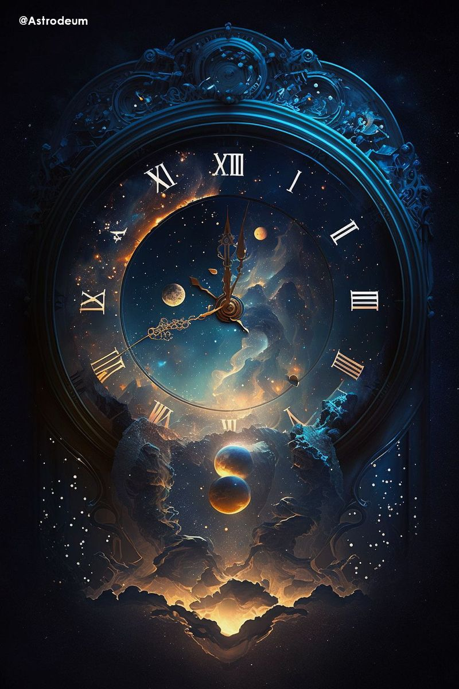
Time Complexity

Slide 46
Time Complexity
O(n²)

Slide 47
Why Backtracking?

Slide 48
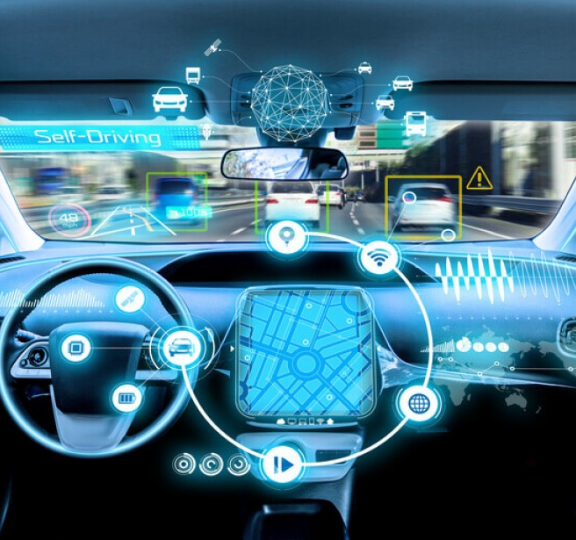
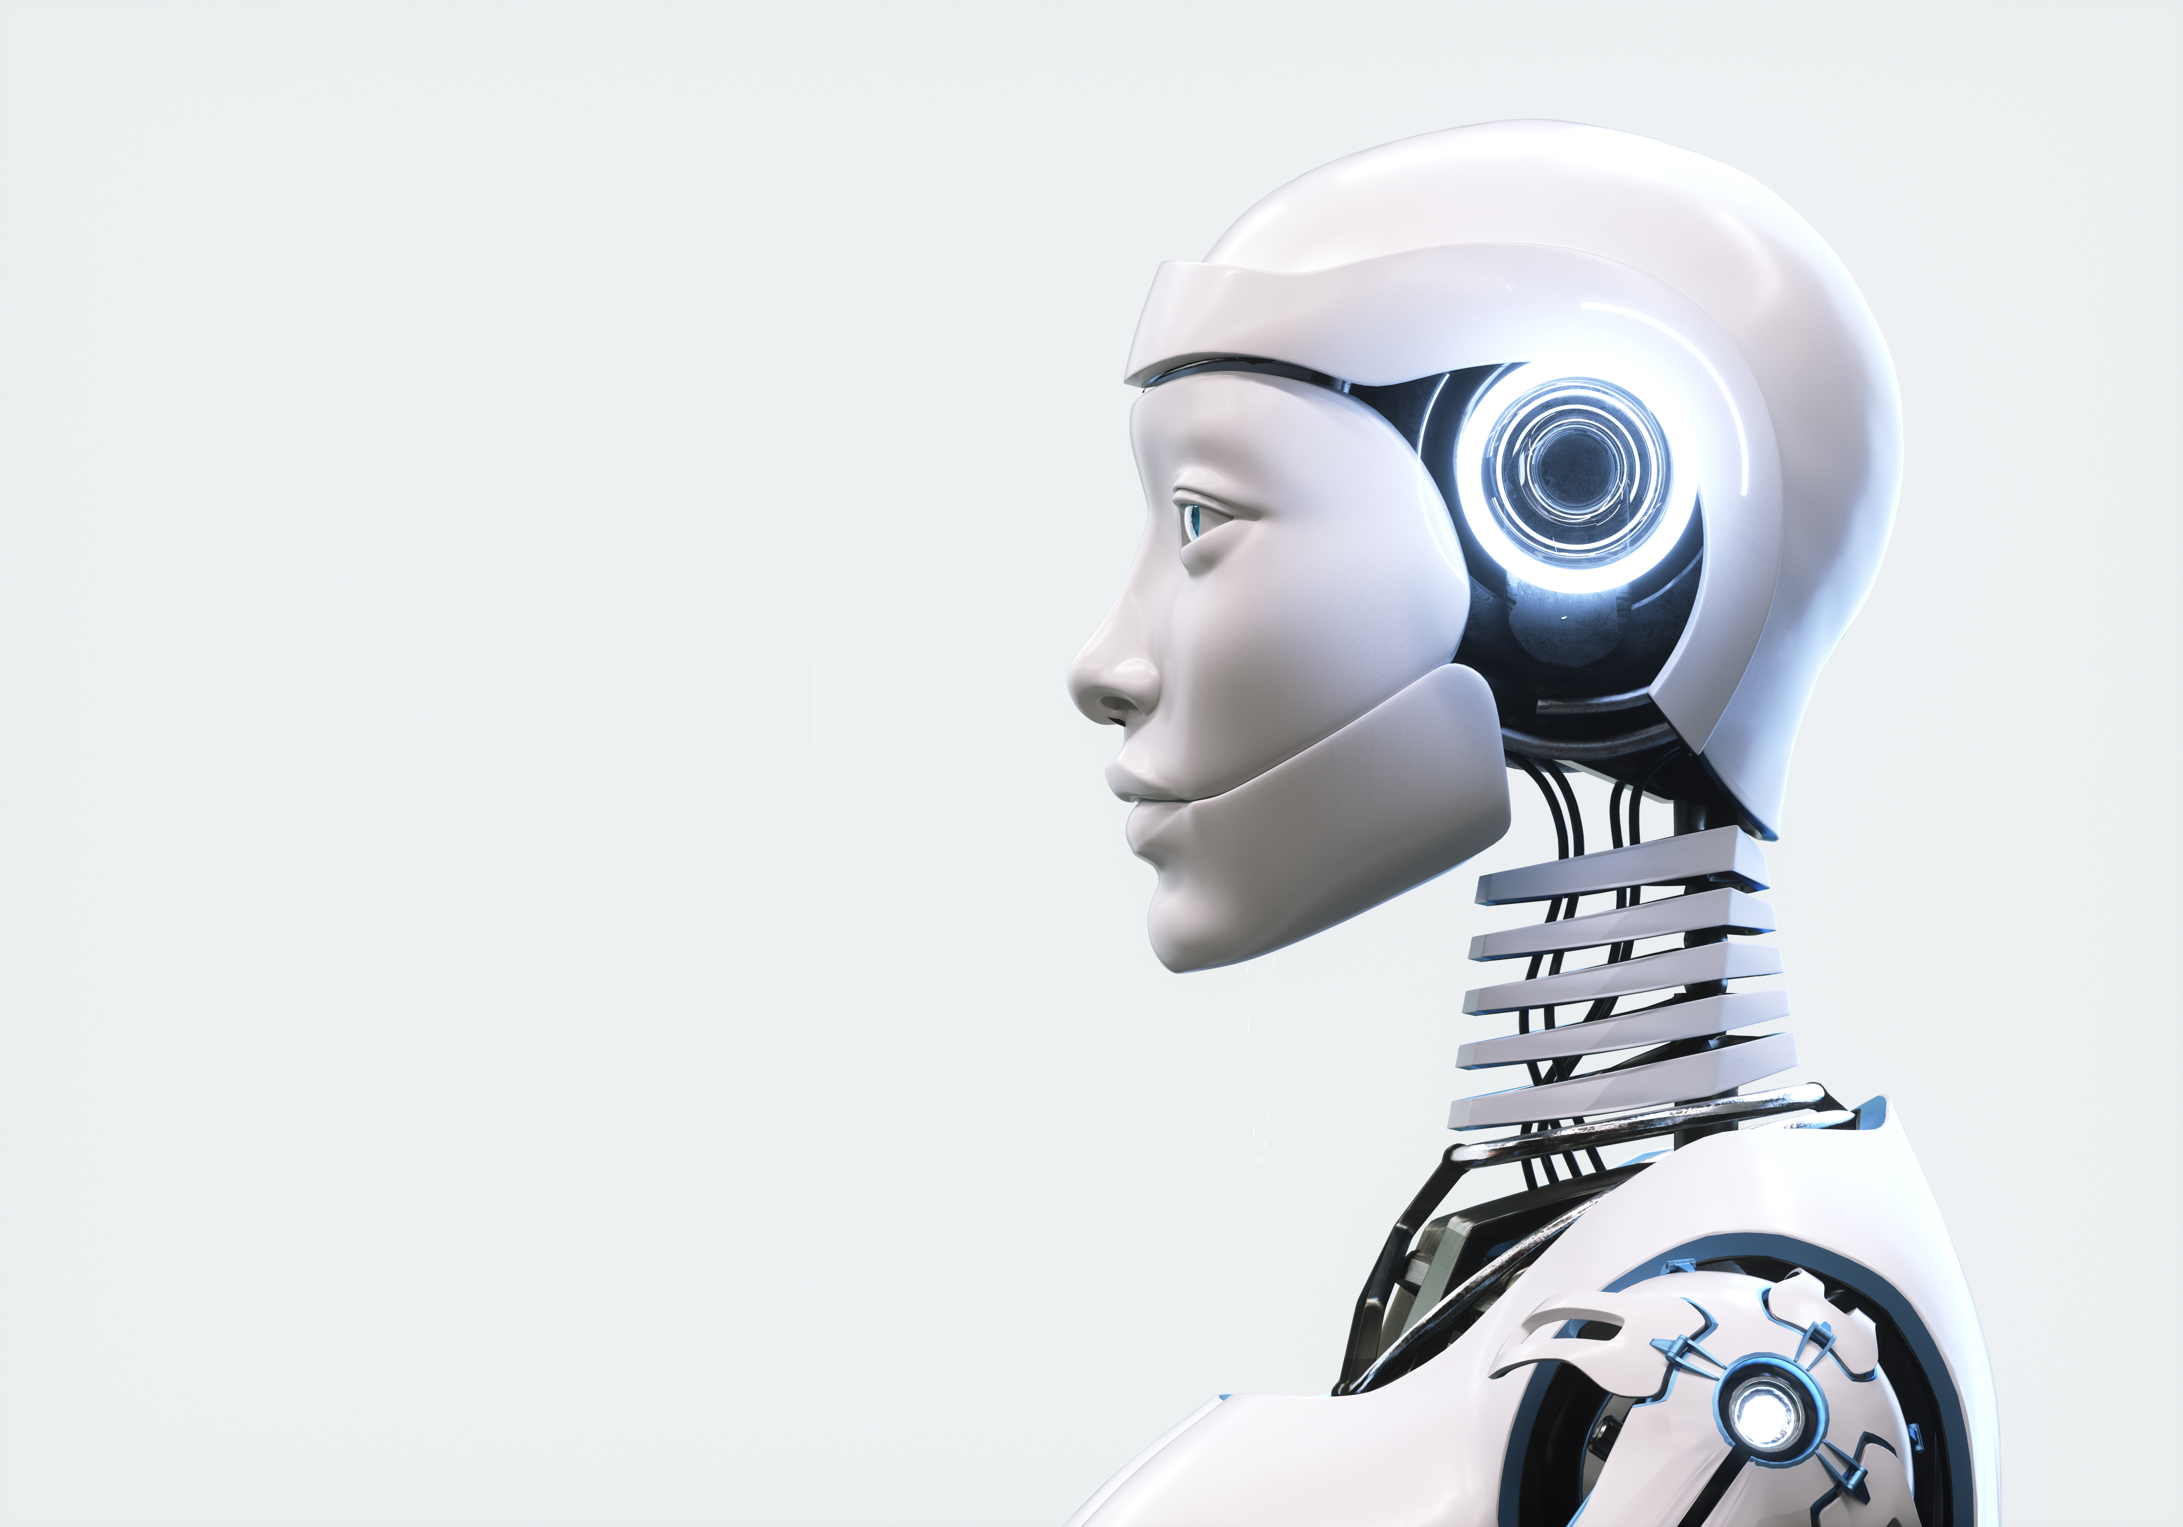
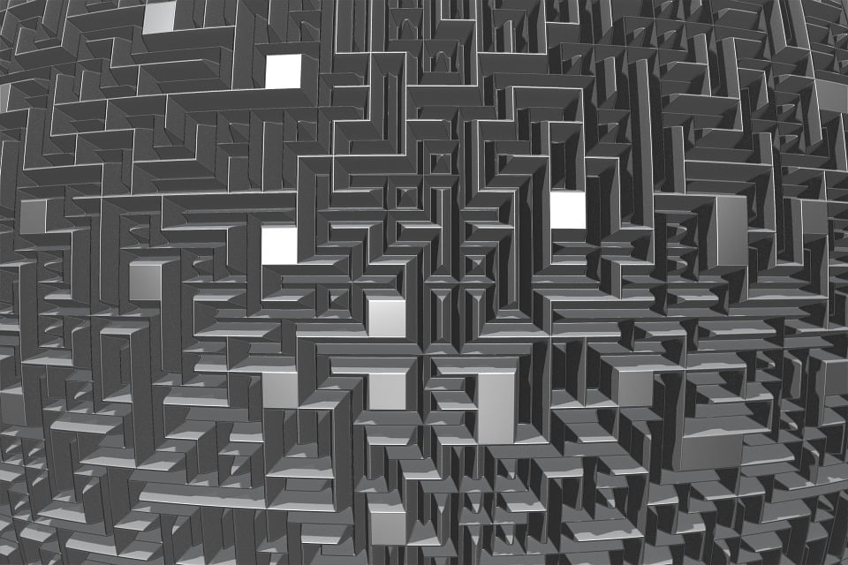
Real Life Solutions
Autonomous Vehicles
Movement in Robotics
Video Games

Slide 49
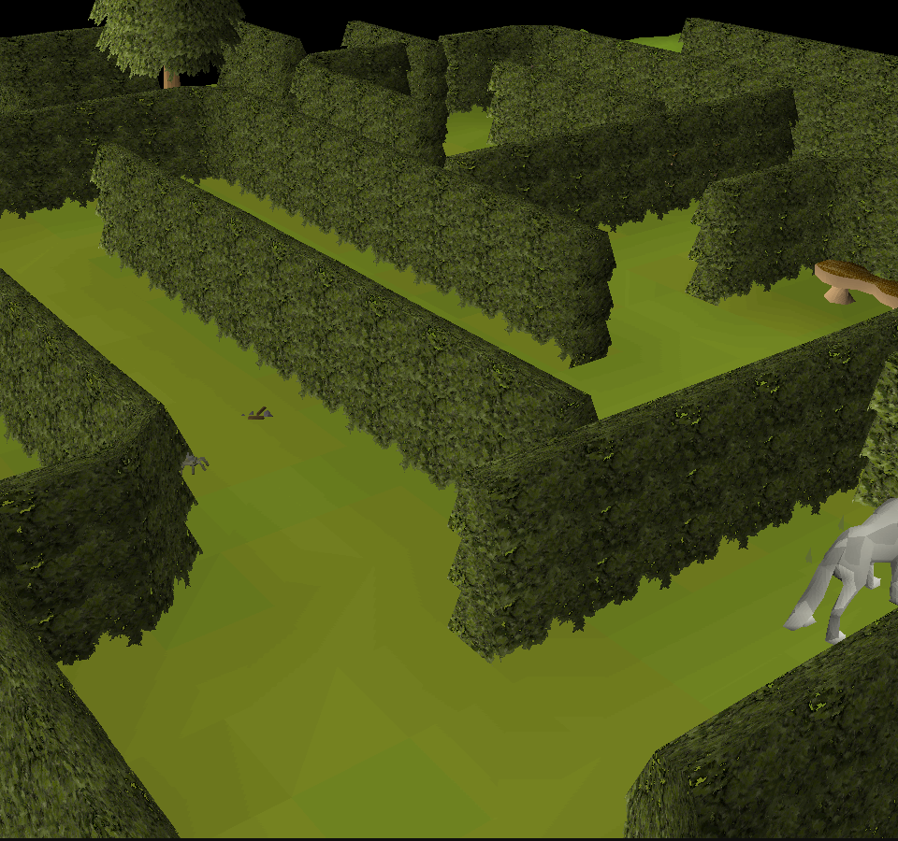
Real Life Solutions
Autonomous Vehicles
Movement in Robotics
Video Games

Slide 50

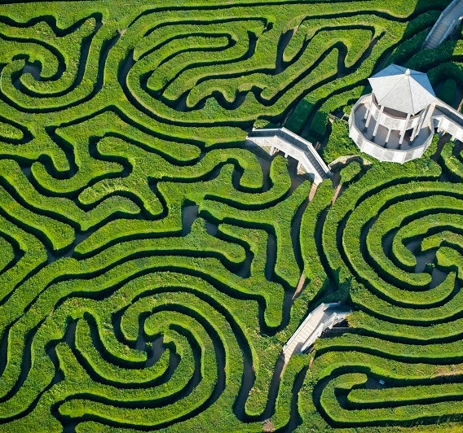
Future Scope
Algorithm Optimisation
Multi-Path Solutions
3D Maze Navigations

Slide 51
Future Scope
Algorithm Optimisation
Multi-Path Solutions
3D Maze Navigations

Slide 52
CONCLUSION

Slide 53
Thanks For listening!
We Would Love to Answer your Queries

Slide 54
Thanks For listening!
We Would Love to Answer your Queries

